Slide 1

Bioinformatics Bootcamp
Special Topic Workshop: “Single Cell RNA-Seq Analysis”
Module 6: Advanced Topics II

Slide 2
scRNA-Seq Downstream Analysis Workflow
Load Data
QC
Normalize & Scale
PCA & Nearest Neighbor Graph
Clustering
Advanced:
Cluster Marker Analysis
Cell Type Identification
Sub-clustering
Trajectories
Cell Cycle Analysis
Cluster DGE
Low Dimensional Embedding

Slide 3
scRNA-Seq Downstream Analysis Workflow
Load Data
QC
Normalize & Scale
PCA & Nearest Neighbor Graph
Clustering
Advanced:
Cluster Marker Analysis
Cell Type Identification
Sub-clustering
Trajectories
Cell Cycle Analysis
Cluster DGE
Low Dimensional Embedding

Slide 4
scRNA-Seq Downstream Analysis Workflow
Load Data
QC
Normalize & Scale
PCA & Nearest Neighbor Graph
Clustering
Advanced:
Cluster Marker Analysis
Cell Type Identification
Sub-clustering
Trajectories
Cell Cycle Analysis
Cluster DGE
Low Dimensional Embedding

Slide 5
scRNA-Seq Downstream Analysis Workflow
Load Data
QC
Normalize & Scale
PCA & Nearest Neighbor Graph
Clustering
Advanced:
Cluster Marker Analysis
Cell Type Identification
Sub-clustering
Trajectories
Cell Cycle Analysis
Cluster DGE
Low Dimensional Embedding

Slide 6
scRNA-Seq Downstream Analysis Workflow
Load Data
QC
Normalize & Scale
PCA & Nearest Neighbor Graph
Clustering
Advanced:
Cluster Marker Analysis
Cell Type Identification
Sub-clustering
Trajectories
Cell Cycle Analysis
Cluster DGE
Low Dimensional Embedding

Slide 7
scRNA-Seq Downstream Analysis Workflow
Load Data
QC
Normalize & Scale
PCA & Nearest Neighbor Graph
Clustering
Advanced:
Cluster Marker Analysis
Cell Type Identification
Sub-clustering
Trajectories
Cell Cycle Analysis
Cluster DGE
Low Dimensional Embedding

Slide 8
scRNA-Seq Downstream Analysis Workflow
Load Data
QC
Normalize & Scale
PCA & Nearest Neighbor Graph
Clustering
Advanced:
Cluster Marker Analysis
Cell Type Identification
Sub-clustering
Trajectories
Cell Cycle Analysis
Cluster DGE
Low Dimensional Embedding

Slide 9
Load Data
QC
Normalize & Scale
PCA & Nearest Neighbor Graph
Clustering
Advanced:
Cluster Marker Analysis
Cell Type Identification
Sub-clustering
Trajectories
Cell Cycle Analysis
Cluster DGE
Low Dimensional Embedding

Slide 10
The Single-Cell Universe
Independent Component Analysis
Load Data
QC
Normalize & Scale
PCA & Nearest Neighbor Graph
Clustering
Advanced:
Cluster Marker Analysis
Cell Type Identification
Sub-clustering
Trajectories
Cell Cycle Analysis
Cluster DGE
Force-directed graphs
Low Dimensional Embedding
Pseudo-alignment
Multimodal Analysis
Differential State analysis
Interactive Visualizations
Weighted Nearest Neighbors
Making Shiny data portals
CNV Infer
Pseudo-bulk analysis
Batch correction
CITE-Seq
Perturb-Seq
Cell-interaction inference
Graph signal processing
Spatial Gene Expression
TCR/BCR clonal analysis
Single-Cell CRISPR Screening
Reference mapping
Co-expression networks in scRNA-Seq
Tree inference
Velocity analysis
NN-based cell classification
CyTOF
Autoencoders
Scran/scanpy (python university)
scATAC-Seq
Custom scRNA-Seq plotting
Imputation
Doublet-detection

Slide 11
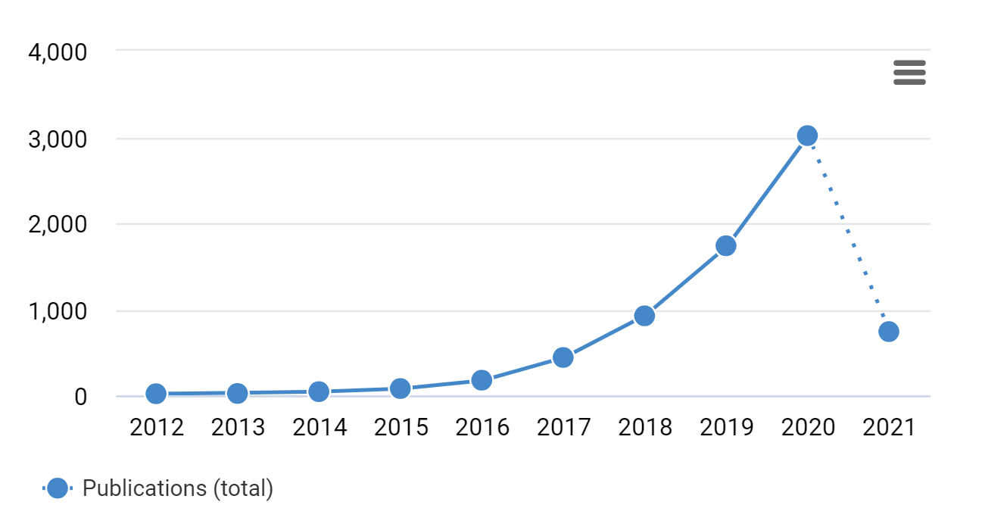
The rise of single cell RNA-Seq
https://app.dimensions.ai/discover/publication?search_mode=content&search_text=scRNA-Seq&search_type=kws&search_field=full_search

Slide 12

Currently tracking 888 single-cell RNA-Seq tools (Mar 2021)
https://www.scrna-tools.org/analysis

Slide 13
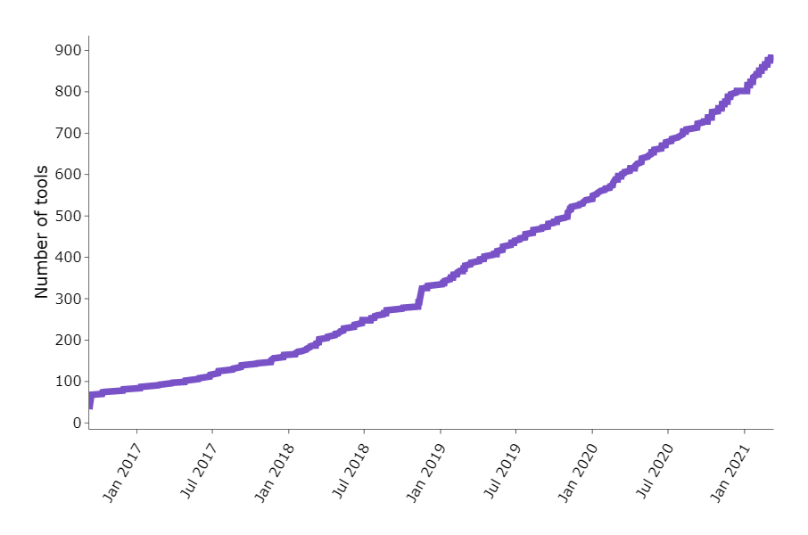
https://www.scrna-tools.org/analysis

Slide 14
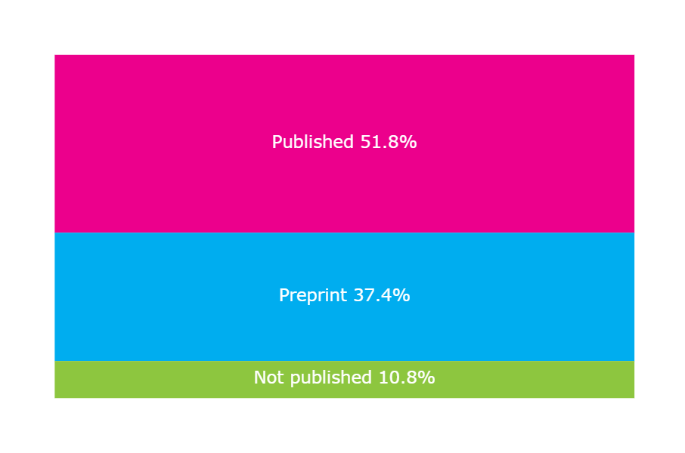
https://www.scrna-tools.org/analysis

Slide 15
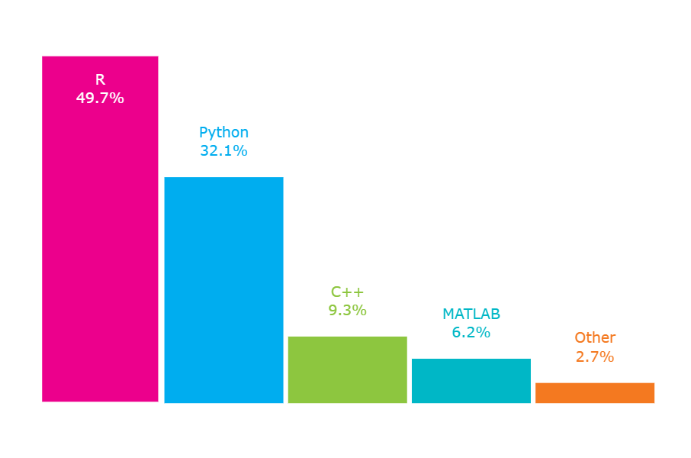
https://www.scrna-tools.org/analysis

Slide 16
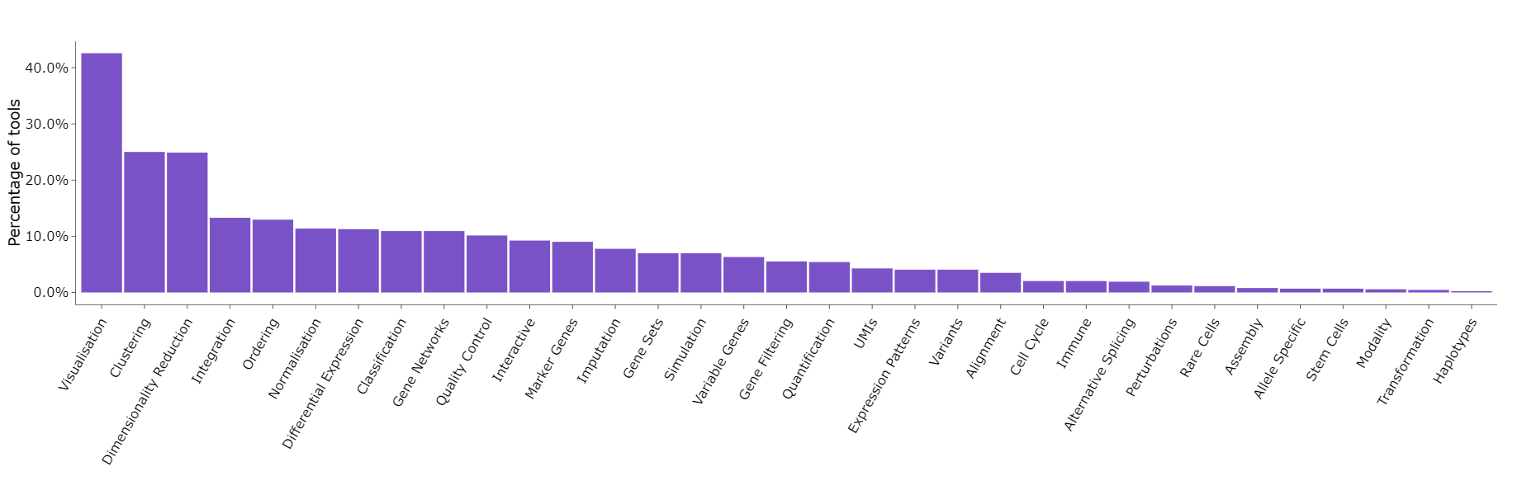
https://www.scrna-tools.org/analysis

Slide 17
The Single-Cell Universe
Independent Component Analysis
Load Data
QC
Normalize & Scale
PCA & Nearest Neighbor Graph
Clustering
Advanced:
Cluster Marker Analysis
Cell Type Identification
Sub-clustering
Trajectories
Cell Cycle Analysis
Cluster DGE
Force-directed graphs
Low Dimensional Embedding
Pseudo-alignment
Multimodal Analysis
Differential State analysis
Interactive Visualizations
Weighted Nearest Neighbors
Making Shiny data portals
CNV Infer
Pseudo-bulk analysis
Batch correction
CITE-Seq
Perturb-Seq
Cell-interaction inference
Graph signal processing
Spatial Gene Expression
TCR/BCR clonal analysis
Single-Cell CRISPR Screening
Reference mapping
Co-expression networks in scRNA-Seq
Tree inference
Velocity analysis
NN-based cell classification
CyTOF
Autoencoders
Scran/scanpy (python university)
scATAC-Seq
Custom scRNA-Seq plotting
Imputation
Doublet-detection

Slide 18
The Single-Cell Universe
Independent Component Analysis
Load Data
QC
Normalize & Scale
PCA & Nearest Neighbor Graph
Clustering
Advanced:
Cluster Marker Analysis
Cell Type Identification
Sub-clustering
Trajectories
Cell Cycle Analysis
Cluster DGE
Force-directed graphs
Low Dimensional Embedding
Pseudo-alignment
Multimodal Analysis
Differential State analysis
Interactive Visualizations
Weighted Nearest Neighbors
Making Shiny data portals
CNV Infer
Pseudo-bulk analysis
Batch correction
CITE-Seq
Perturb-Seq
Cell-interaction inference
Graph signal processing
Spatial Gene Expression
TCR/BCR clonal analysis
Single-Cell CRISPR Screening
Reference mapping
Co-expression networks in scRNA-Seq
Tree inference
Velocity analysis
NN-based cell classification
CyTOF
Autoencoders
Scran/scanpy (python university)
scATAC-Seq
Custom scRNA-Seq plotting
Imputation
Doublet-detection

Slide 19
The Single-Cell Universe
Independent Component Analysis
Load Data
QC
Normalize & Scale
PCA & Nearest Neighbor Graph
Clustering
Advanced:
Cluster Marker Analysis
Cell Type Identification
Sub-clustering
Trajectories
Cell Cycle Analysis
Cluster DGE
Force-directed graphs
Low Dimensional Embedding
Pseudo-alignment
Multimodal Analysis
Differential State analysis
Interactive Visualizations
Weighted Nearest Neighbors
Making Shiny data portals
CNV Infer
Pseudo-bulk analysis
Batch correction
CITE-Seq
Perturb-Seq
Cell-interaction inference
Graph signal processing
Spatial Gene Expression
TCR/BCR clonal analysis
Single-Cell CRISPR Screening
Reference mapping
Co-expression networks in scRNA-Seq
Tree inference
Velocity analysis
NN-based cell classification
CyTOF
Autoencoders
Scran/scanpy (python university)
scATAC-Seq
Custom scRNA-Seq plotting
Imputation
Doublet-detection

Slide 20
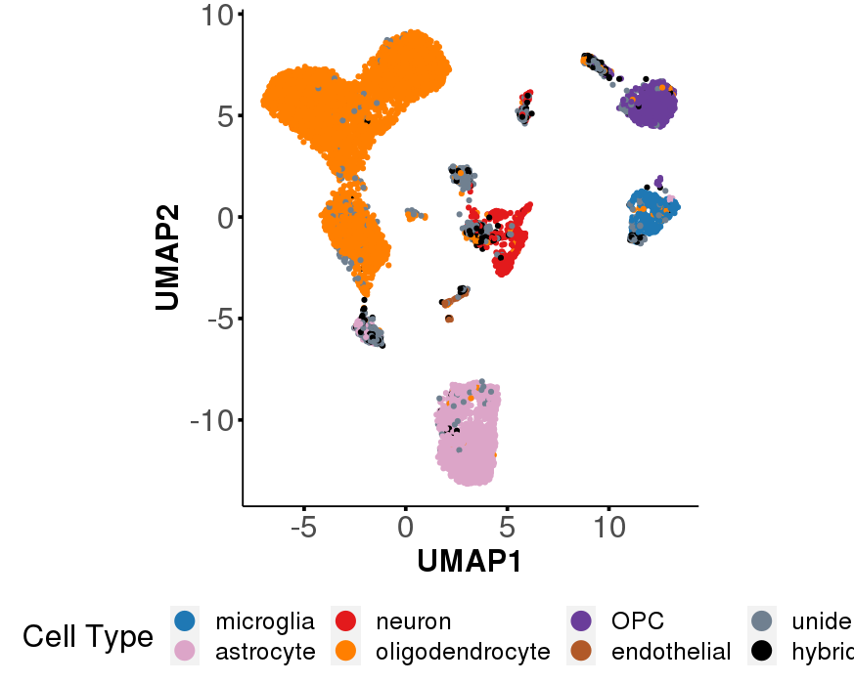
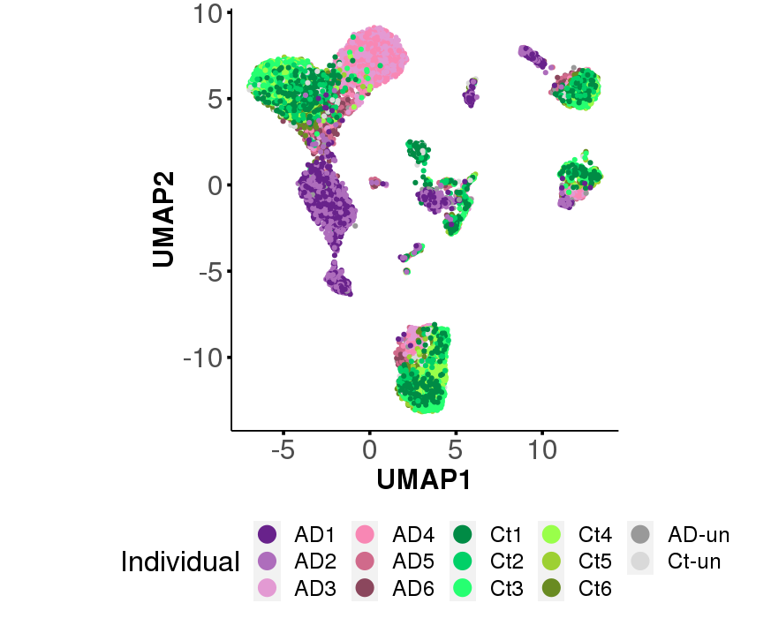
Differential State Analysis
http://adsn.ddnetbio.com/

Slide 21
Differential State Analysis
DS Analysis determines the impact of a condition on gene expression within a cell type.
http://adsn.ddnetbio.com/

Slide 22
Differential State Analysis
Questions:
What is the impact of AD on specific cell types?
What is the impact of AD across cell types?
http://adsn.ddnetbio.com/

Slide 23
Differential State Analysis
Questions:
What is the impact of AD on specific cell types?
What is the impact of AD across cell types?
http://adsn.ddnetbio.com/

Slide 24
Differential State Analysis
Questions:
What is the impact of AD on specific cell types?
What is the impact of AD across cell types?
http://adsn.ddnetbio.com/

Slide 25
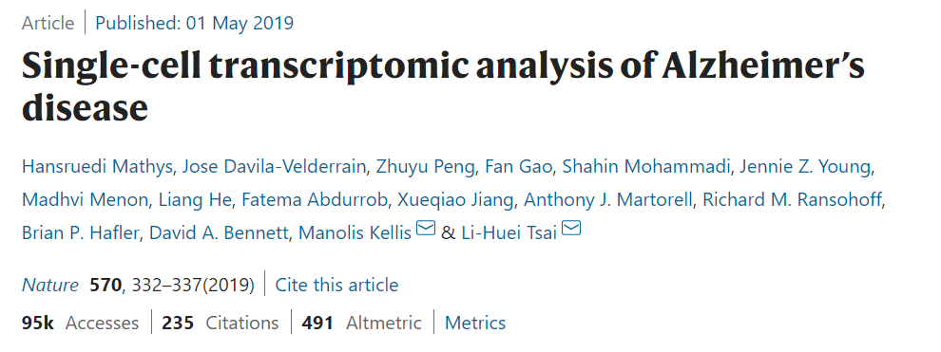

Slide 26
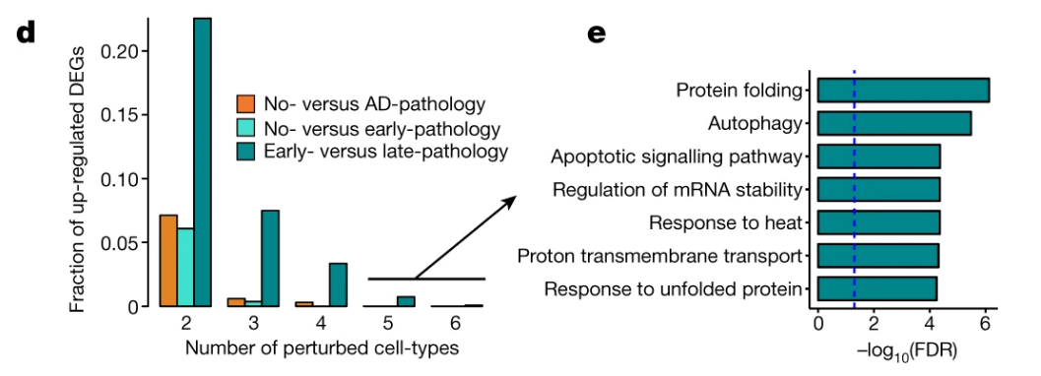
Differential State Analysis

Slide 27
Differential State Analysis
How to perform Differential State Analysis:
Typical DGE scRNA-Seq DGE analysis using Seurat
Pseudobulk analysis with muscat
Graph signal analysis using MELD

Slide 28
Differential State Analysis
How to perform Differential State Analysis:
Typical DGE scRNA-Seq DGE analysis using Seurat
Pseudobulk analysis with muscat
Graph signal analysis using MELD

Slide 29
The Single-Cell Universe
Independent Component Analysis
Load Data
QC
Normalize & Scale
PCA & Nearest Neighbor Graph
Clustering
Advanced:
Cluster Marker Analysis
Cell Type Identification
Sub-clustering
Trajectories
Cell Cycle Analysis
Cluster DGE
Force-directed graphs
Low Dimensional Embedding
Pseudo-alignment
Multimodal Analysis
Differential State analysis
Interactive Visualizations
Weighted Nearest Neighbors
Making Shiny data portals
CNV Infer
Pseudo-bulk analysis
Batch correction
CITE-Seq
Perturb-Seq
Cell-interaction inference
Graph signal processing
Spatial Gene Expression
TCR/BCR clonal analysis
Single-Cell CRISPR Screening
Reference mapping
Co-expression networks in scRNA-Seq
Tree inference
Velocity analysis
NN-based cell classification
CyTOF
Autoencoders
Scran/scanpy (python university)
scATAC-Seq
Custom scRNA-Seq plotting
Imputation
Doublet-detection

Slide 30
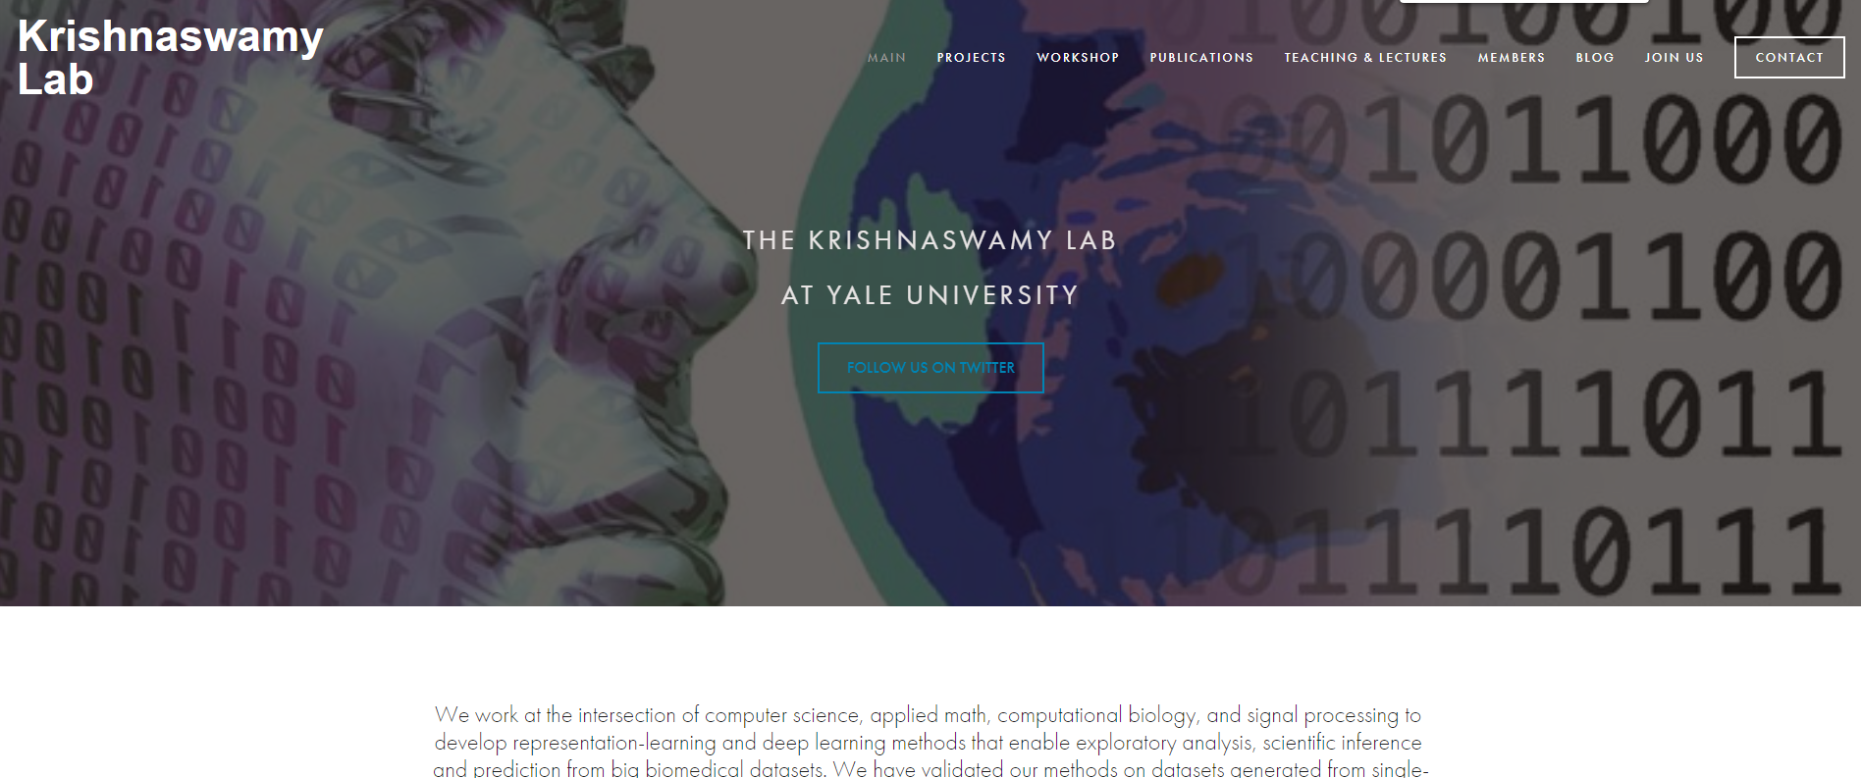
Graph Signal Processing
https://www.krishnaswamylab.org/

Slide 31
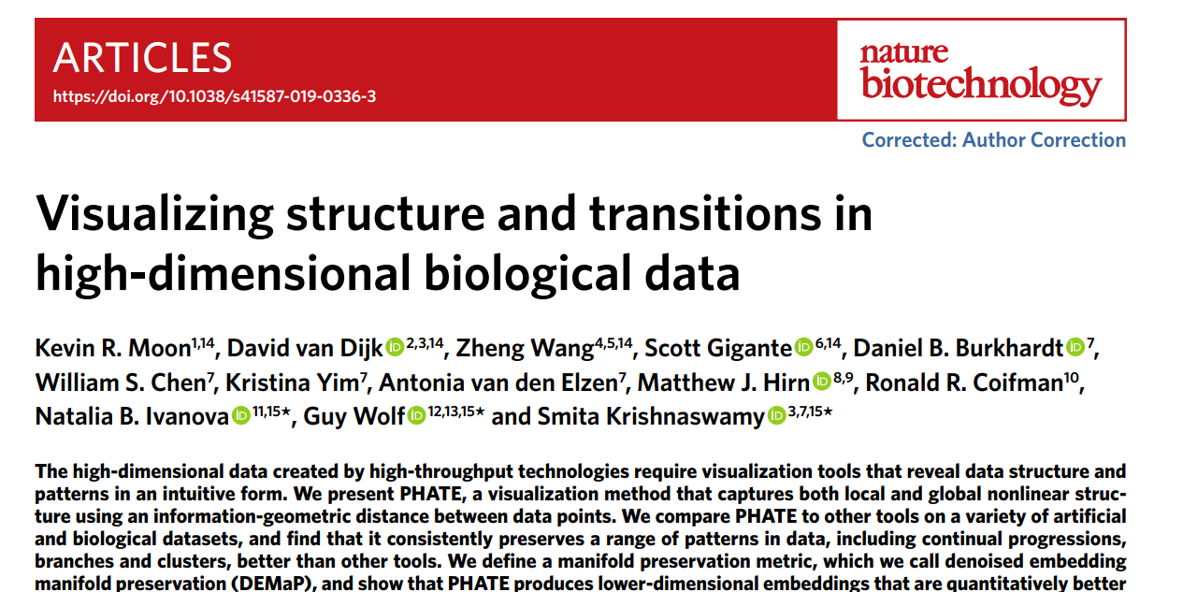

Slide 32
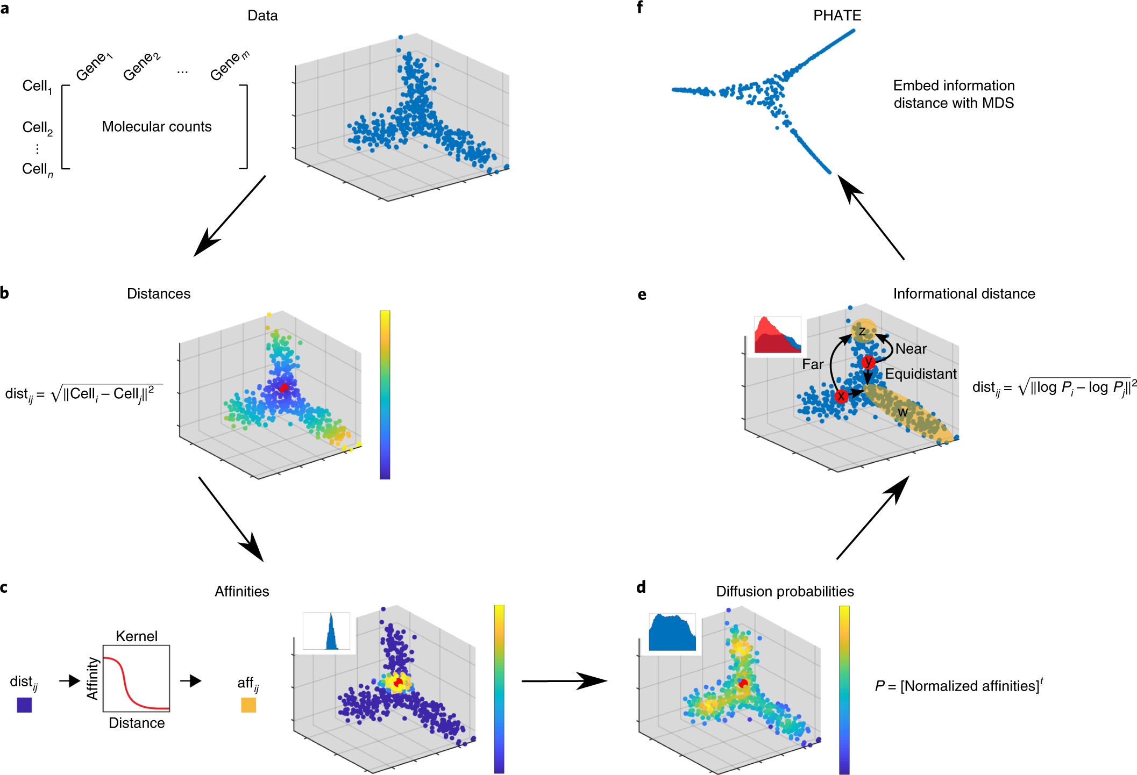
Graph Signal Processing
Moon, K.R., van Dijk, D., Wang, Z. et al. Visualizing structure and transitions in high-dimensional biological data. Nat Biotechnol 37, 1482–1492 (2019). https://doi.org/10.1038/s41587-019-0336-3

Slide 33
Moon, K.R., van Dijk, D., Wang, Z. et al. Visualizing structure and transitions in high-dimensional biological data. Nat Biotechnol 37, 1482–1492 (2019). https://doi.org/10.1038/s41587-019-0336-3

Slide 34
PCA
Moon, K.R., van Dijk, D., Wang, Z. et al. Visualizing structure and transitions in high-dimensional biological data. Nat Biotechnol 37, 1482–1492 (2019). https://doi.org/10.1038/s41587-019-0336-3

Slide 35
Moon, K.R., van Dijk, D., Wang, Z. et al. Visualizing structure and transitions in high-dimensional biological data. Nat Biotechnol 37, 1482–1492 (2019). https://doi.org/10.1038/s41587-019-0336-3

Slide 36
Moon, K.R., van Dijk, D., Wang, Z. et al. Visualizing structure and transitions in high-dimensional biological data. Nat Biotechnol 37, 1482–1492 (2019). https://doi.org/10.1038/s41587-019-0336-3

Slide 37
Graph Signal Processing
Moon, K.R., van Dijk, D., Wang, Z. et al. Visualizing structure and transitions in high-dimensional biological data. Nat Biotechnol 37, 1482–1492 (2019). https://doi.org/10.1038/s41587-019-0336-3

Slide 38
Moon, K.R., van Dijk, D., Wang, Z. et al. Visualizing structure and transitions in high-dimensional biological data. Nat Biotechnol 37, 1482–1492 (2019). https://doi.org/10.1038/s41587-019-0336-3

Slide 39
1. MAGIC
2. PHATE
Moon, K.R., van Dijk, D., Wang, Z. et al. Visualizing structure and transitions in high-dimensional biological data. Nat Biotechnol 37, 1482–1492 (2019). https://doi.org/10.1038/s41587-019-0336-3

Slide 40
1. MAGIC
2. PHATE
Moon, K.R., van Dijk, D., Wang, Z. et al. Visualizing structure and transitions in high-dimensional biological data. Nat Biotechnol 37, 1482–1492 (2019). https://doi.org/10.1038/s41587-019-0336-3

Slide 41
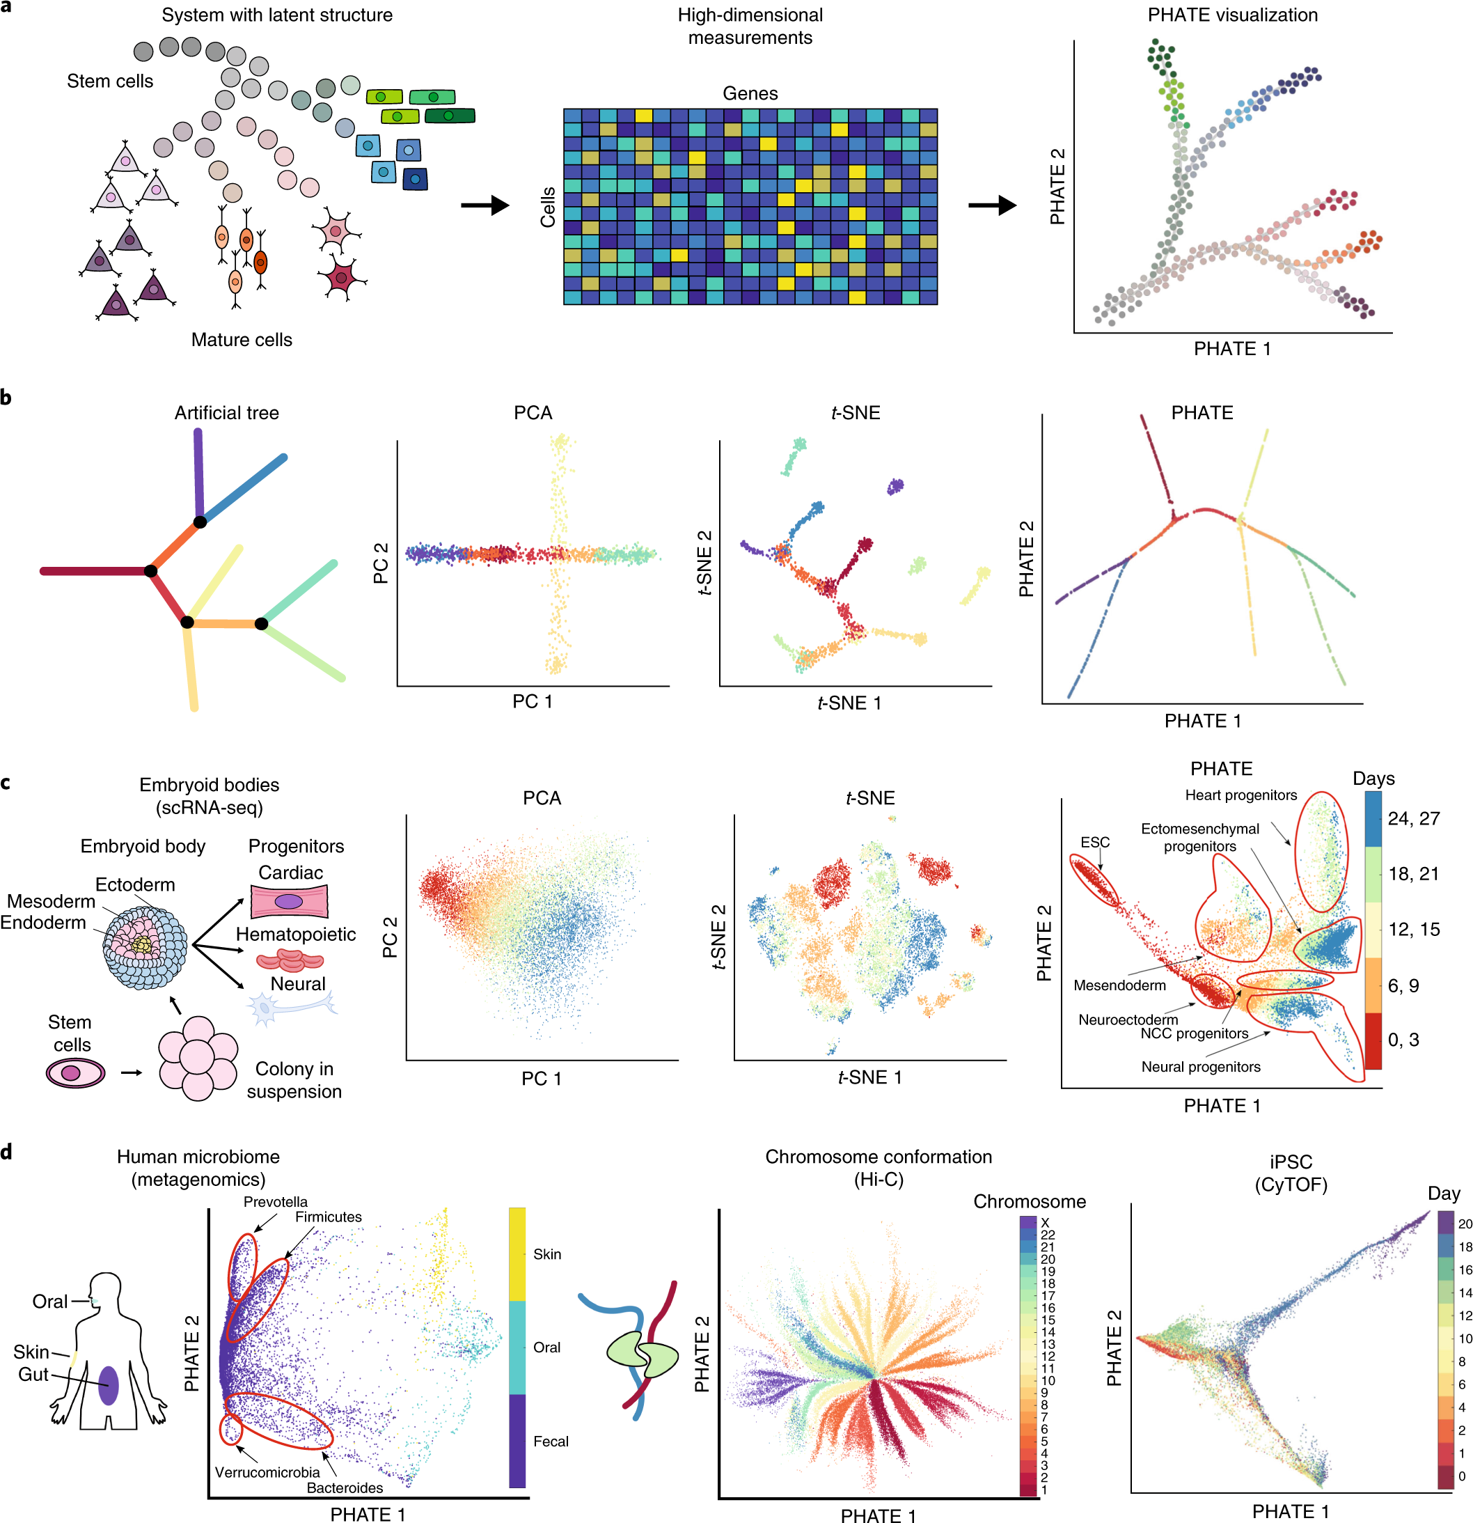
Graph Signal Processing
Moon, K.R., van Dijk, D., Wang, Z. et al. Visualizing structure and transitions in high-dimensional biological data. Nat Biotechnol 37, 1482–1492 (2019). https://doi.org/10.1038/s41587-019-0336-3

Slide 42
Graph Signal Processing
Moon, K.R., van Dijk, D., Wang, Z. et al. Visualizing structure and transitions in high-dimensional biological data. Nat Biotechnol 37, 1482–1492 (2019). https://doi.org/10.1038/s41587-019-0336-3

Slide 43
Graph Signal Processing
Moon, K.R., van Dijk, D., Wang, Z. et al. Visualizing structure and transitions in high-dimensional biological data. Nat Biotechnol 37, 1482–1492 (2019). https://doi.org/10.1038/s41587-019-0336-3

Slide 44
Graph Signal Processing
Moon, K.R., van Dijk, D., Wang, Z. et al. Visualizing structure and transitions in high-dimensional biological data. Nat Biotechnol 37, 1482–1492 (2019). https://doi.org/10.1038/s41587-019-0336-3

Slide 45
Moon, K.R., van Dijk, D., Wang, Z. et al. Visualizing structure and transitions in high-dimensional biological data. Nat Biotechnol 37, 1482–1492 (2019). https://doi.org/10.1038/s41587-019-0336-3

Slide 46
Graph Signal Processing
Moon, K.R., van Dijk, D., Wang, Z. et al. Visualizing structure and transitions in high-dimensional biological data. Nat Biotechnol 37, 1482–1492 (2019). https://doi.org/10.1038/s41587-019-0336-3

Slide 47
Moon, K.R., van Dijk, D., Wang, Z. et al. Visualizing structure and transitions in high-dimensional biological data. Nat Biotechnol 37, 1482–1492 (2019). https://doi.org/10.1038/s41587-019-0336-3

Slide 48
PHATE summarized
Finds local and global structure
Assumes a well-connected graph
Moon, K.R., van Dijk, D., Wang, Z. et al. Visualizing structure and transitions in high-dimensional biological data. Nat Biotechnol 37, 1482–1492 (2019). https://doi.org/10.1038/s41587-019-0336-3

Slide 49
1. MAGIC
2. PHATE
Moon, K.R., van Dijk, D., Wang, Z. et al. Visualizing structure and transitions in high-dimensional biological data. Nat Biotechnol 37, 1482–1492 (2019). https://doi.org/10.1038/s41587-019-0336-3

Slide 50
1. MAGIC
2. PHATE
Moon, K.R., van Dijk, D., Wang, Z. et al. Visualizing structure and transitions in high-dimensional biological data. Nat Biotechnol 37, 1482–1492 (2019). https://doi.org/10.1038/s41587-019-0336-3

Slide 51
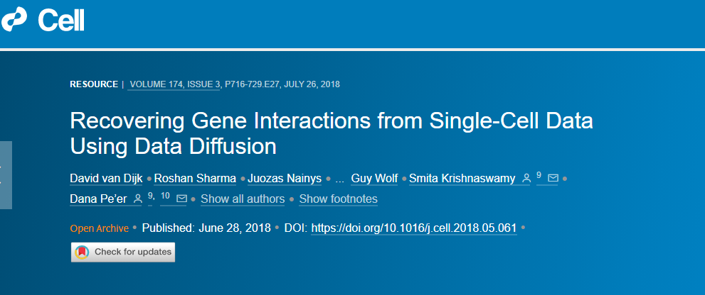
Graph Signal Processing
van Dijk D, Sharma R, Nainys J, Yim K, Kathail P, Carr AJ, Burdziak C, Moon KR, Chaffer CL, Pattabiraman D, Bierie B, Mazutis L, Wolf G, Krishnaswamy S, Pe'er D. Recovering Gene Interactions from Single-Cell Data Using Data Diffusion. Cell. 2018 Jul 26;174(3):716-729.e27. doi: 10.1016/j.cell.2018.05.061. Epub 2018 Jun 28. PMID: 29961576; PMCID: PMC6771278.

Slide 52
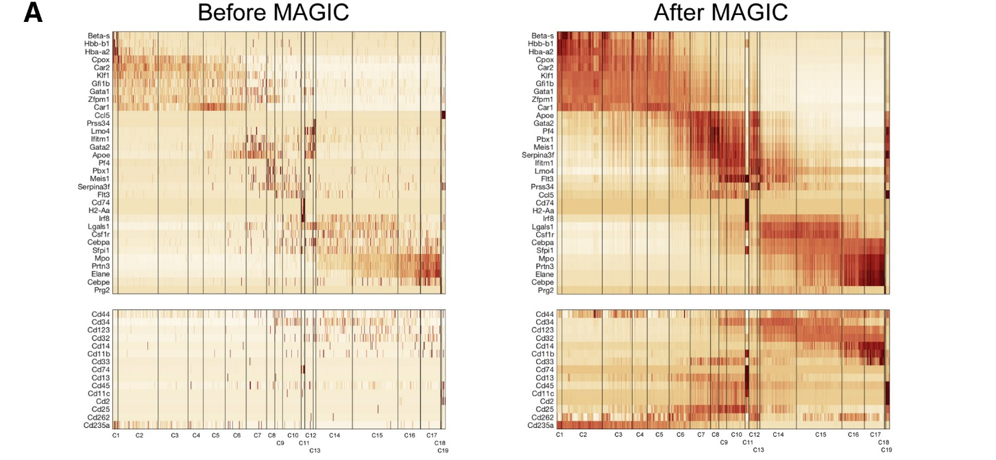
Graph Signal Processing
van Dijk D, Sharma R, Nainys J, Yim K, Kathail P, Carr AJ, Burdziak C, Moon KR, Chaffer CL, Pattabiraman D, Bierie B, Mazutis L, Wolf G, Krishnaswamy S, Pe'er D. Recovering Gene Interactions from Single-Cell Data Using Data Diffusion. Cell. 2018 Jul 26;174(3):716-729.e27. doi: 10.1016/j.cell.2018.05.061. Epub 2018 Jun 28. PMID: 29961576; PMCID: PMC6771278.

Slide 53
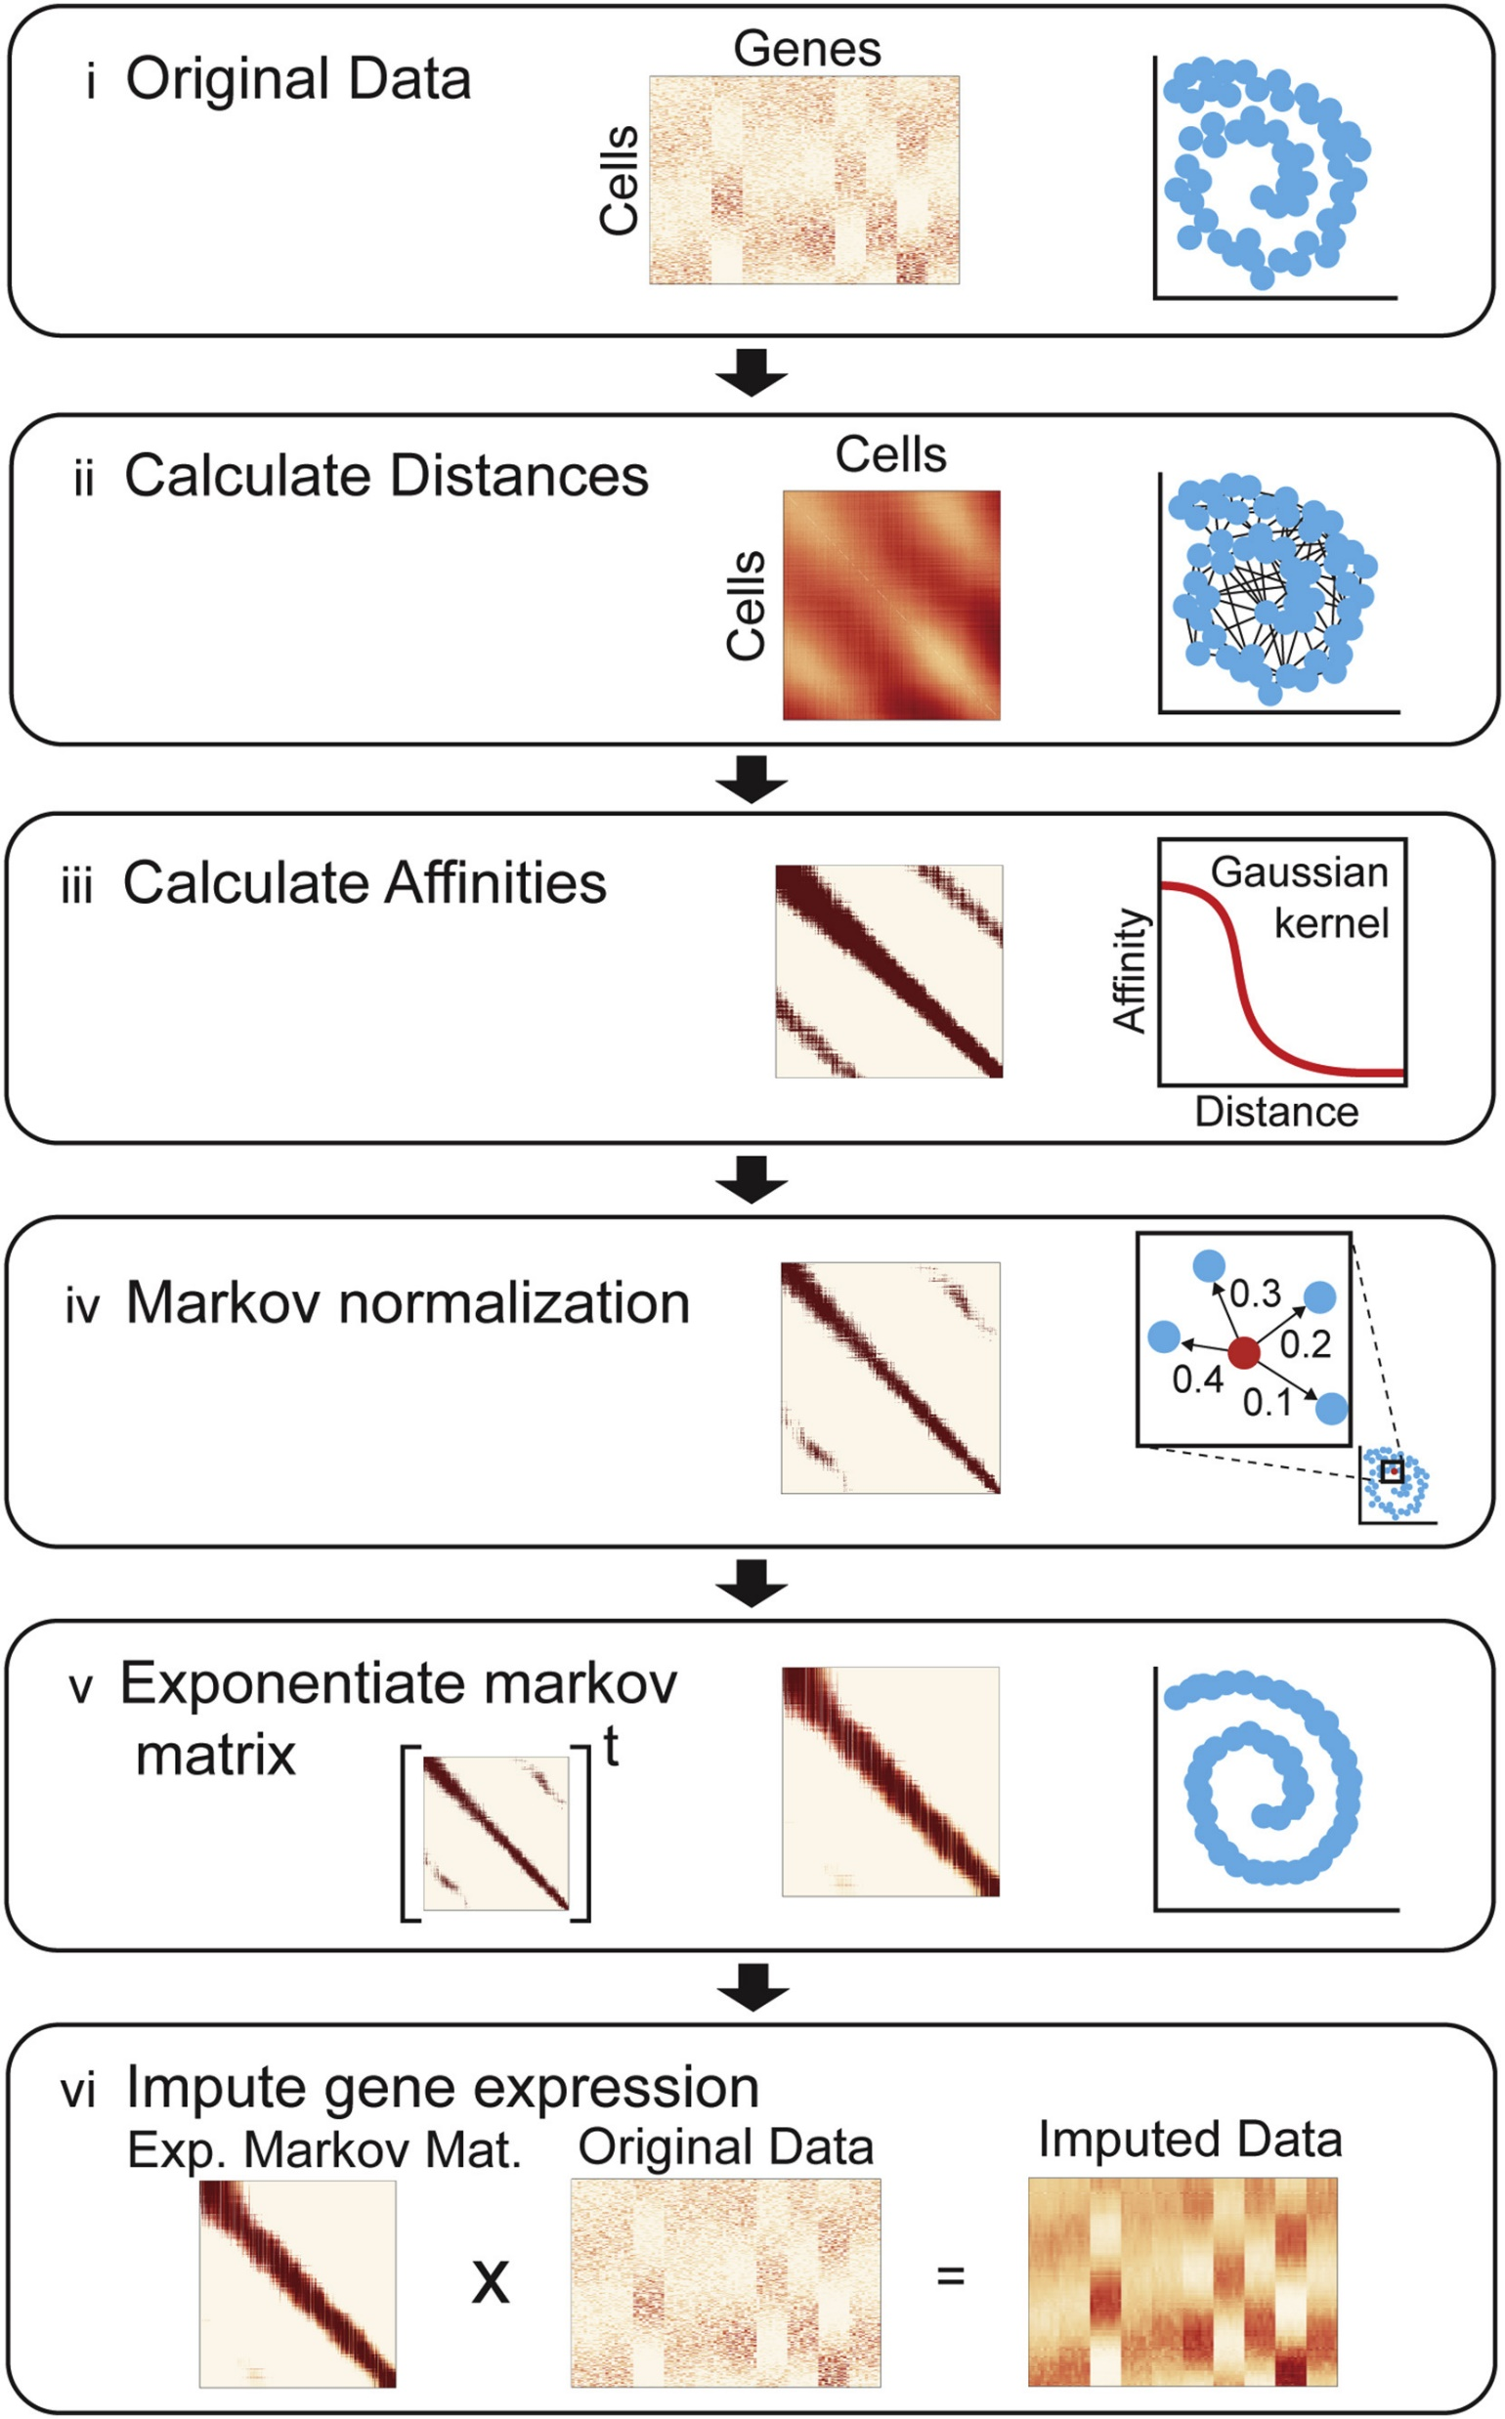

Graph Signal Processing
van Dijk D, Sharma R, Nainys J, Yim K, Kathail P, Carr AJ, Burdziak C, Moon KR, Chaffer CL, Pattabiraman D, Bierie B, Mazutis L, Wolf G, Krishnaswamy S, Pe'er D. Recovering Gene Interactions from Single-Cell Data Using Data Diffusion. Cell. 2018 Jul 26;174(3):716-729.e27. doi: 10.1016/j.cell.2018.05.061. Epub 2018 Jun 28. PMID: 29961576; PMCID: PMC6771278.

Slide 54
Graph Signal Processing
van Dijk D, Sharma R, Nainys J, Yim K, Kathail P, Carr AJ, Burdziak C, Moon KR, Chaffer CL, Pattabiraman D, Bierie B, Mazutis L, Wolf G, Krishnaswamy S, Pe'er D. Recovering Gene Interactions from Single-Cell Data Using Data Diffusion. Cell. 2018 Jul 26;174(3):716-729.e27. doi: 10.1016/j.cell.2018.05.061. Epub 2018 Jun 28. PMID: 29961576; PMCID: PMC6771278.

Slide 55
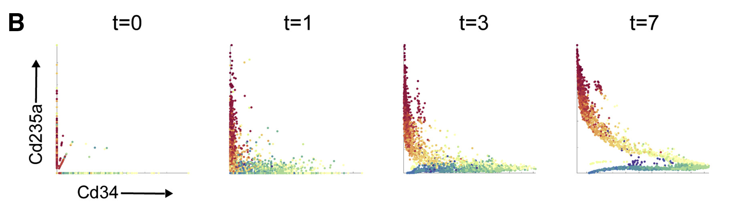
Graph Signal Processing
van Dijk D, Sharma R, Nainys J, Yim K, Kathail P, Carr AJ, Burdziak C, Moon KR, Chaffer CL, Pattabiraman D, Bierie B, Mazutis L, Wolf G, Krishnaswamy S, Pe'er D. Recovering Gene Interactions from Single-Cell Data Using Data Diffusion. Cell. 2018 Jul 26;174(3):716-729.e27. doi: 10.1016/j.cell.2018.05.061. Epub 2018 Jun 28. PMID: 29961576; PMCID: PMC6771278.

Slide 56
Graph Signal Processing
MAGIC summarized
Imputes missing values using data diffusion
Assumes that neighbors are informative
van Dijk D, Sharma R, Nainys J, Yim K, Kathail P, Carr AJ, Burdziak C, Moon KR, Chaffer CL, Pattabiraman D, Bierie B, Mazutis L, Wolf G, Krishnaswamy S, Pe'er D. Recovering Gene Interactions from Single-Cell Data Using Data Diffusion. Cell. 2018 Jul 26;174(3):716-729.e27. doi: 10.1016/j.cell.2018.05.061. Epub 2018 Jun 28. PMID: 29961576; PMCID: PMC6771278.

Slide 57
1. MAGIC
2. PHATE
Moon, K.R., van Dijk, D., Wang, Z. et al. Visualizing structure and transitions in high-dimensional biological data. Nat Biotechnol 37, 1482–1492 (2019). https://doi.org/10.1038/s41587-019-0336-3

Slide 58
Summary

Slide 59
What we talked about:

Slide 60
What we talked about:
scRNA-Seq vs Bulk RNA-Seq

Slide 61
What we talked about:
scRNA-Seq vs Bulk RNA-Seq
scRNA-Seq wetlab processing

Slide 62
What we talked about:
scRNA-Seq vs Bulk RNA-Seq
scRNA-Seq wetlab processing
Basic upstream and downstream QC

Slide 63
What we talked about:
scRNA-Seq vs Bulk RNA-Seq
scRNA-Seq wetlab processing
Basic upstream and downstream QC
Normalization, scaling, PCA

Slide 64
What we talked about:
scRNA-Seq vs Bulk RNA-Seq
scRNA-Seq wetlab processing
Basic upstream and downstream QC
Normalization, scaling, PCA
Uncovering dataset structure with clustering and embedding

Slide 65
What we talked about:
scRNA-Seq vs Bulk RNA-Seq
scRNA-Seq wetlab processing
Basic upstream and downstream QC
Normalization, scaling, PCA
Uncovering dataset structure with clustering and embedding
Cell type annotation, marker genes, and cell DGE

Slide 66
What we talked about:
scRNA-Seq vs Bulk RNA-Seq
scRNA-Seq wetlab processing
Basic upstream and downstream QC
Normalization, scaling, PCA
Uncovering dataset structure with clustering and embedding
Cell type annotation, marker genes, and cell DGE
Different types of plots for scRNA-Seq

Slide 67
What we talked about:
scRNA-Seq vs Bulk RNA-Seq
scRNA-Seq wetlab processing
Basic upstream and downstream QC
Normalization, scaling, PCA
Uncovering dataset structure with clustering and embedding
Cell type annotation, marker genes, and cell DGE
Different types of plots for scRNA-Seq
Cell cycle scoring and Module Scoring

Slide 68
What we talked about:
scRNA-Seq vs Bulk RNA-Seq
scRNA-Seq wetlab processing
Basic upstream and downstream QC
Normalization, scaling, PCA
Uncovering dataset structure with clustering and embedding
Cell type annotation, marker genes, and cell DGE
Different types of plots for scRNA-Seq
Cell cycle scoring and Module Scoring
Graph Signal Processing

Slide 69
What we talked about:
scRNA-Seq vs Bulk RNA-Seq
scRNA-Seq wetlab processing
Basic upstream and downstream QC
Normalization, scaling, PCA
Uncovering dataset structure with clustering and embedding
Cell type annotation, marker genes, and cell DGE
Different types of plots for scRNA-Seq
Cell cycle scoring and Module Scoring
Graph Signal Processing
Differential State analysis and pseudobulk

Slide 70
What we talked about:
scRNA-Seq vs Bulk RNA-Seq
scRNA-Seq wetlab processing
Basic upstream and downstream QC
Normalization, scaling, PCA
Uncovering dataset structure with clustering and embedding
Cell type annotation, marker genes, and cell DGE
Different types of plots for scRNA-Seq
Cell cycle scoring and Module Scoring
Graph Signal Processing
Differential State analysis and pseudobulk
Customized plotting and interactive charts
Trajectory analysis

Slide 71
What we talked about:
scRNA-Seq vs Bulk RNA-Seq
scRNA-Seq wetlab processing
Basic upstream and downstream QC
Normalization, scaling, PCA
Uncovering dataset structure with clustering and embedding
Cell type annotation, marker genes, and cell DGE
Different types of plots for scRNA-Seq
Cell cycle scoring and Module Scoring
Graph Signal Processing
Differential State analysis and pseudobulk
Customized plotting and interactive charts
Trajectory analysis

Slide 72
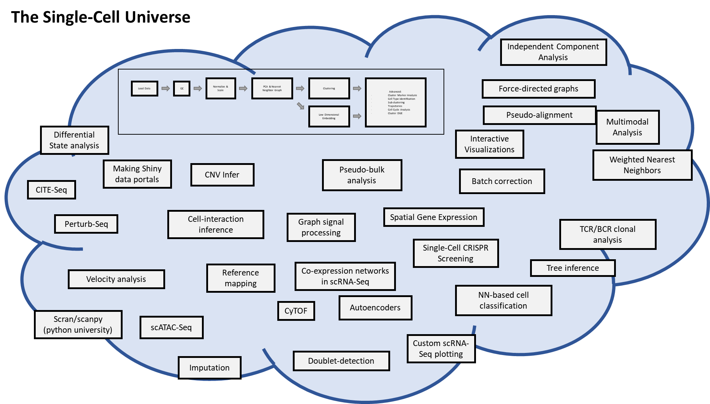
What we talked about:
scRNA-Seq vs Bulk RNA-Seq
scRNA-Seq wetlab processing
Basic upstream and downstream QC
Normalization, scaling, PCA
Uncovering dataset structure with clustering and embedding
Cell type annotation, marker genes, and cell DGE
Different types of plots for scRNA-Seq
Cell cycle scoring and Module Scoring
Graph Signal Processing
Differential State analysis and pseudobulk
Customized plotting and interactive charts
Trajectory analysis

Slide 73

What we talked about:
scRNA-Seq vs Bulk RNA-Seq
scRNA-Seq wetlab processing
Basic upstream and downstream QC
Normalization, scaling, PCA
Uncovering dataset structure with clustering and embedding
Cell type annotation, marker genes, and cell DGE
Different types of plots for scRNA-Seq
Cell cycle scoring and Module Scoring
Graph Signal Processing
Differential State analysis and pseudobulk
Customized plotting and interactive charts
Trajectory analysis

Slide 74
What we talked about:
scRNA-Seq vs Bulk RNA-Seq
scRNA-Seq wetlab processing
Basic upstream and downstream QC
Normalization, scaling, PCA
Uncovering dataset structure with clustering and embedding
Cell type annotation, marker genes, and cell DGE
Different types of plots for scRNA-Seq
Cell cycle scoring and Module Scoring
Graph Signal Processing
Differential State analysis and pseudobulk
Customized plotting and interactive charts
Trajectory analysis

Slide 75
What we talked about:
scRNA-Seq vs Bulk RNA-Seq
scRNA-Seq wetlab processing
Basic upstream and downstream QC
Normalization, scaling, PCA
Uncovering dataset structure with clustering and embedding
Cell type annotation, marker genes, and cell DGE
Different types of plots for scRNA-Seq
Cell cycle scoring and Module Scoring
Graph Signal Processing
Differential State analysis and pseudobulk
Customized plotting and interactive charts
Trajectory analysis
The Basics

Slide 76
Now, it’s up to you.

Slide 77
Next-steps
Projects and additional help

Slide 78
Project (optional)
Prompt: Identify and Characterize metastatic subpopulations in triple-negative breast cancer tumors.
Details / Data: Included on github
Due: no specific date. This is for your benefit if you want to pursue a real-world project and get feedback on it.

Slide 79
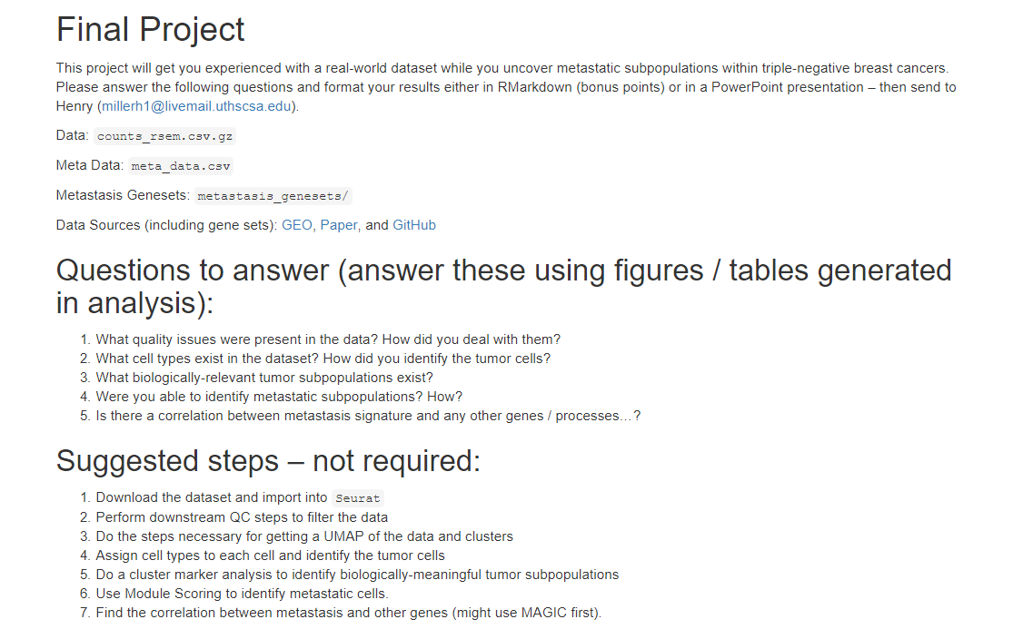

Slide 80
Next Steps:
Keep moving.
Find projects to practice on
Get feedback from mentors (and BIG club)
Start trying and developing new approaches
Communicate with others.
Opportunities:
Post-doc positions at UTHSCSA (on the website)
Join the Bioinformatics Research Network (on the website also)

Slide 81
Thank you! Questions?
What we talked about:
scRNA-Seq vs Bulk RNA-Seq
scRNA-Seq wetlab processing
Basic upstream and downstream QC
Normalization, scaling, PCA
Uncovering dataset structure with clustering and embedding
Cell type annotation, marker genes, and cell DGE
Different types of plots for scRNA-Seq
Cell cycle scoring and Module Scoring
Graph Signal Processing
Differential State analysis and pseudobulk
Customized plotting and interactive charts
Trajectory analysis

